Slide 1
Evaluation of Lompoc’s Planned Impact Fee Update (May 2020)
Steve Bridge
November 2020

Slide 2
Top Level
Study is a Bottoms Up Evaluation
Uses a List of Bottom Up Requirements (LMP)
Does Not Consider City Budget Projections /Capabilities
Bottom Up Evaluations Generally Inflate Requirements
May Be Out of Sync With Existing Conditions
Top Down Approach
Establishes Operation and Budget Boundaries
Requires Justifications for New Requirements
Industry Standards Are To Establish Top Down Parameters Before Handing Off for Bottom Up Evaluation

Slide 3
Study Characteristics
Existing Spine Improvements Depreciable Assets $1.2 Billion Used for Proportional Analysis
Study Does Not to Address Capital Deficiencies
Last Study was 2002 / 2003
Creates a Strong Correlation to Lompoc Facility Master Plan (LMP May 2020)
LMP Is a Bottoms Up Document
Implementation Dependent on Capital Improvement Funds
Total Capital Improvements Funds Required are $452 Million
Should Correlate to the General Plan Build Out
Assumes a Complete Buildout of All In-City Area

Slide 4
Data & Assumptions
Present Population ~ 45,000 (2018 Census)
Growth Projected to ~52,000 (2050 SBCAG Projection)
15% or ½ % a year
DIF Growth Projection 47,668 Total Build out
Quote, “the city is likely to see …dwelling units developed decrease each year”
$451.3 Million Total Capital Improvements Required (LMP)
~20% Covered by DIF
This Means Under This Plan Lompoc Has to Allocate Approximately $360M of Non-DIF Funds
Is This Really Feasible?
Collecting Development Fees, but Low Probability of Ever Implementing Underlying Improvements

Slide 5
Comparison Proposed and Existing (2019-2020 Ref: Attachment A)
DIF Land Use Type Proposed DIF Existing % Incr Notes
Detached Dwelling Unit $32,938/DU $23,929/DU 38%
Attached Dwelling Unit $29,268/DU $14,430/DU 103%
Mobile Home Dwelling Unit $24, 187/DU $11,053/DU 119%
Commercial Lodging $8, 130/KU $3,293/KU 147% Asm Avg Rm Size 500 sq ft
Retail/Service/Office Uses $7.122/SF $23.865/SF -70% Avg Comm & Gnrl % Services
Self Storage Uses $5.035/SF 19.931/SF -75% Asm Comm Service
Business Park Uses $5.203/SF $29.798/SF -83% Asm Comm Gnrl
Industrial Uses $4.345/SF. $6.37/ SF -32% Avg Light and Heavy Ind
Institutional Use $5.505/SF $17.931/SF -69% Asm Comm Services
Significant Philosophic Change In Proposed Structure

Slide 6
Assumptions Increasing Potential Fees
Law Enforcement
Vehicle to Officer Ratio .936
New Culture Direction to Move Officers Into Community
Live in Town, Foot or Bicycle Patrols
Special Weapons and Tactics Equipment
Fire
New Fire Station (According to Report only 25% utilization)
New Truck
10 New Firefighters
Traffic Signal Preemptions for 12 signals (~$10.5 Million)
Note: Any Expenses Imply Additional Non DIF Investments

Slide 7
Specific Assumptions Increasing Potential Fees (Continued)
Circulation
20 New Traffic Lights (1/2 Million a piece)
3 Bridge Projects (Central Ave Extension)
Electrical
Not Included
Water
Negative Balance Requires Attention
Waste Water
Negative Balance Requires Attention
Library
No Comment
Note: Any Expenses Imply Additional Non DIF Investments

Slide 8
Specific Assumptions Increasing Potential Fees (Continued)
Refuse
No Comment
General Facilities
City Hall Reconfiguration
Expansion of Car Fleet for Employees
Public Use Facilities
Additional Community Center Space
Aquatics Facilities
Additional Aquatics Space
Park Land (Presently 3.6 acres/1000, Standard is 3 acres / 1000)
No Comment:
Note, Every Additional Park Increases Operational Liability
Note: Any Expenses Imply Additional Non DIF Investments

Slide 9
Case Study
Old Record Building Improvement Project
Team Create
Reduced Architecture Plan
5 Retail Spaces
3 or 4 Residential Units
Negotiations With Owner
Funding Obtained
Projected Costs For Improvements $300 - $350K
Impact Fees ~$125,000 to $162,000
Increase in Cost Terminated Project
Projected Loss of Annual Business Revenue ~$1,322,000
Unintended Impact of DIF on
Existing Structure Improvements

Slide 10
Recommendation
Review and Reduce Requirements
Eliminate Any Infeasible or Undesired Requirements
Possible Example: Central Ave Extension
Possible Example: Twenty New Traffic Lights
Possible Example: Move Patrols to Foot and Bicycle
Create Reduced Impacted Fees for Abandoned Existing Structures
Impact Fee Philosophy Can Be Used to Create City Characteristics

Slide 11
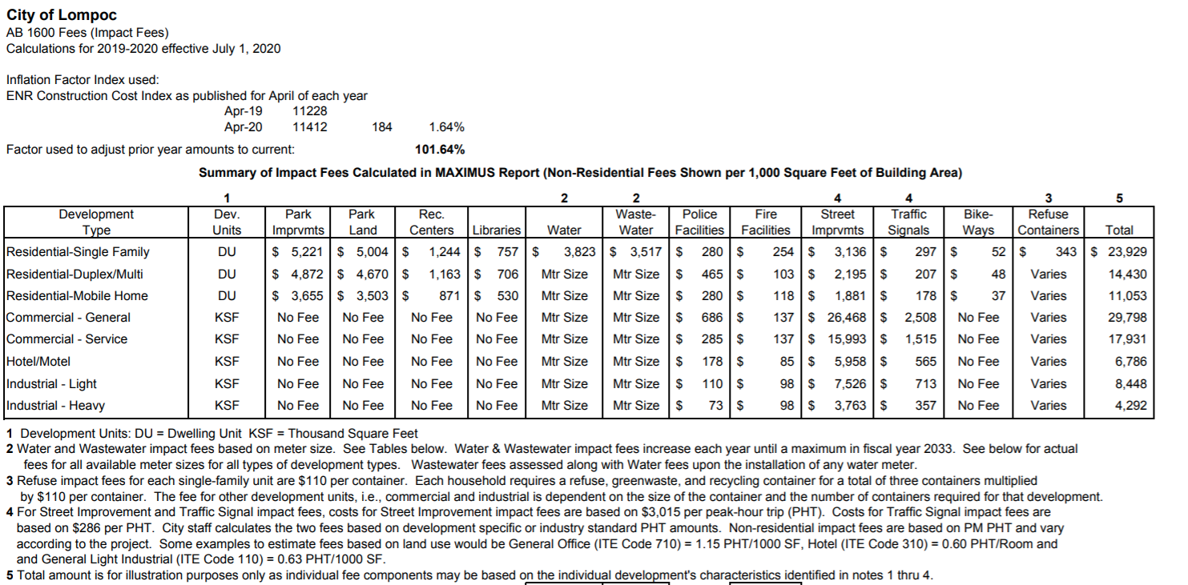
Attachment A Existing City Fee Structure (City Website)

